Slide 1
EDCI 338
Julia Celinski
Julie Hu
Marissa Waddell
Yoghini Kandasamy
Notes:
Hellooo and welcome! This is our final project for EDCI 338: Social Media and Personalized Learning

Slide 2
Personal Learning Networks
What is a PLN?
A way of connecting people and learning from each other
Motivators Encouraging Connections:
Diverse insight
Broadened community
Wealth of knowledge
Notes:
A central topic that became a recurring theme through this course was the concept of personal learning networks.
What is a PLN?
→ Personal learning networks are a type of networking through the use of social media. This is a way that people can connect with each other by building and enhancing relationships in ways that have been made much simpler and more common by use of the internet. Social media has helped expedite this process like none other, as connections between people can be made quicker and easier than in the past.
Motivators:
→ There are numerous motivators that encourage individuals to participate in networked publics, but I would attribute the largest piece in the motivation puzzle to be FOMO, (or the fear of missing out). As the world grows each day, social media is there to document anything and everything that is going on, and no one wants to miss a minute of the action. By using social media to the best of its abilities, people are able to stay up to date with different things occurring around the world on a magnitude of scales. This can range from seeing a picture of your newborn niece in another part of the world and catching up with your loved ones in different time zones, to watching a press release and receiving information about something newsworthy. Other things that may motivate people to participate in networked places include personal gain, such as connections with followers or moving up the social ladder.

Slide 3
Digital Identity
What is digital identity?
An online presence that is portrayed on social media
Can vary based on the level, such as:
Personal or professional
Individual or organization
Risk VS Reward:
Risk → compromising positions, bad press
Reward → expanding your network, connecting with like minded people
Notes:
What is digital identity?
→ A digital identity is the version of an individual or an organization that is portrayed on social media. The approach to digital identity, whether personal or professional, affects the use of social media in many ways, such as the type of interactions that are occurring. On a personal level, people may be less thoughtful about what they are putting onto the internet, whereas professionals may be more cautious about what they are posting. This could result in professionals censoring the content they post, creating a false depiction of who they truly are. Benefits of the convergence of digital identities can be the fostering of communities that come together to help in areas that need assistance.
Risk:
→ E Risks associated with public communications may be comprising your reputation or finding yourself in a situation will less than pleasant individuals. Rewards associated with public communications may be expanding your network and connecting with more like minded people within your communities.
→ the internet is forever!
→ the internet is an extremely powerful tool. When used for good, wonderful people can find their way to each other and incredible things can happen.very reward comes coupled with risk, and there is plenty of that in public communications. Risks associated with public communications may be comprising your reputation or finding yourself in a situation will less than pleasant individuals. Rewards associated with public communications may be expanding your network and connecting with more like minded people within your communities.Every reward comes coupled with risk, and there is plenty of that in public communications. Risks associated with public communications may be comprising your reputation or finding yourself in a situation will less than pleasant individuals. Rewards associated with public communications may be expanding your network and connecting with more like minded people within your communities.

Slide 4
Digital Identity and V&R Mapping
Digital Identity is the online presence of an individual
Covid-19 made digital identities were very prominent in our society, as many jobs and social settings were replicated in online settings
Makes it hard to trust the person on the other side of the screen, learning to source out reliable information is key
When using something on the internet, our mode of engagement tends to fall on a spectrum;
Visitor mode, Resident mode, Personal mode, and Institutional mode
Notes:
Digital identity- an online presence of an individual
As a result from COVID-19, our digital identity were really the main and only identity we got to display at the time, they became much more prominent as we had no option of in person identity and who we were online displayed the entirety of who we were at the time
And it Makes it harder to trust the person on the other side of the screen, which is why knowing how to source out reliable information is a very important skill
when we use something on the internet, our mode of engagement tends to fall on a spectrum:
Visitor mode- entails using something on the internet without leaving a trace ex: google search
Resident mode- the goal is social presence and connecting with other people, leave social trace ex: Instagram
Personal- just as is
Institutional- work-related/professional context
Personalizing each response taking into consideration, is it vitisor mode or resident mode? Personal or institutional
This year we have been Made familiar with new platforms like zoom, while we as UVic students were also getting used to new school platform, BrightSpaces
Question: From an employer's perspective based on my V&R map and digital identity, what would they easily be able to find online?
o my resident mode social network engagements are set to private settings, only allowing people to access it who I have specifically given allowance to, ex: accepting friend requests on facebook/Instagram

Slide 5
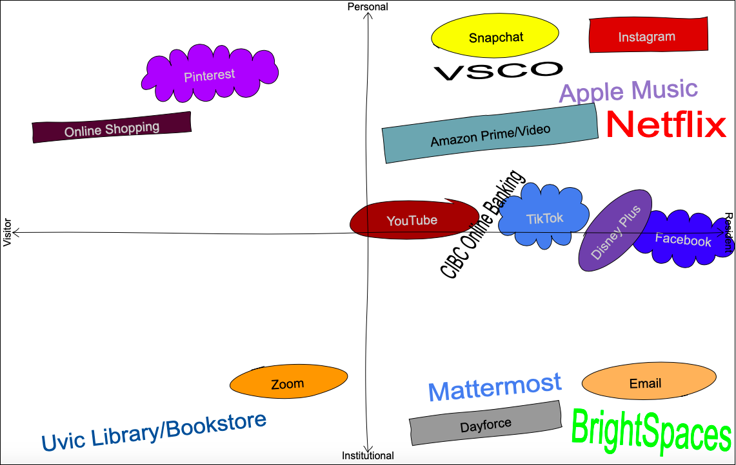
Digital Identity and V&R Mapping Cont’d
A result of Covid-19, students (and professors) have had to adapt and become familiarized with new platforms like Zoom
Question: From an employer's perspective based on my V&R map and digital identity, what would they easily be able to find online?
My resident mode social network engagements are set to private settings

Slide 6
PLN space through Social Media platforms
According to this pandemic spread all world, a new form of PLN space through social media platforms has been create, which is Online classroom. I know many of my chineses friends would love to join into online classroom. is very similar to zoom in that you can turn on the camera and microphone. But unlike zoom, it is an open site that anyone can access, thus creating the atmosphere of studying in a library.
The advantage that you can enter a group and have a discussion or just study.
The bad side that allowing everyone in may result in fraudsters or bad guys coming in.（Because it lack of requirement of personal digital idenity, so that it’s not a very secure environment.)

Slide 7
Question : What is your opinion on the importance of both Personal Digital Identity and Professional Digital Identity?
Notes:
Answer:
I feel a personal digital identity is more personalized and helps shed light on our personality in a more relaxed setting while a professional digital identity is a perspective in a more restricted setting or to say the least.

Slide 8
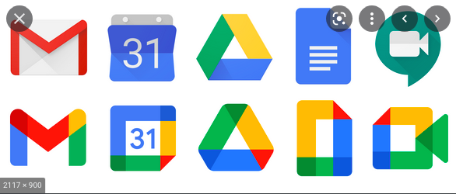
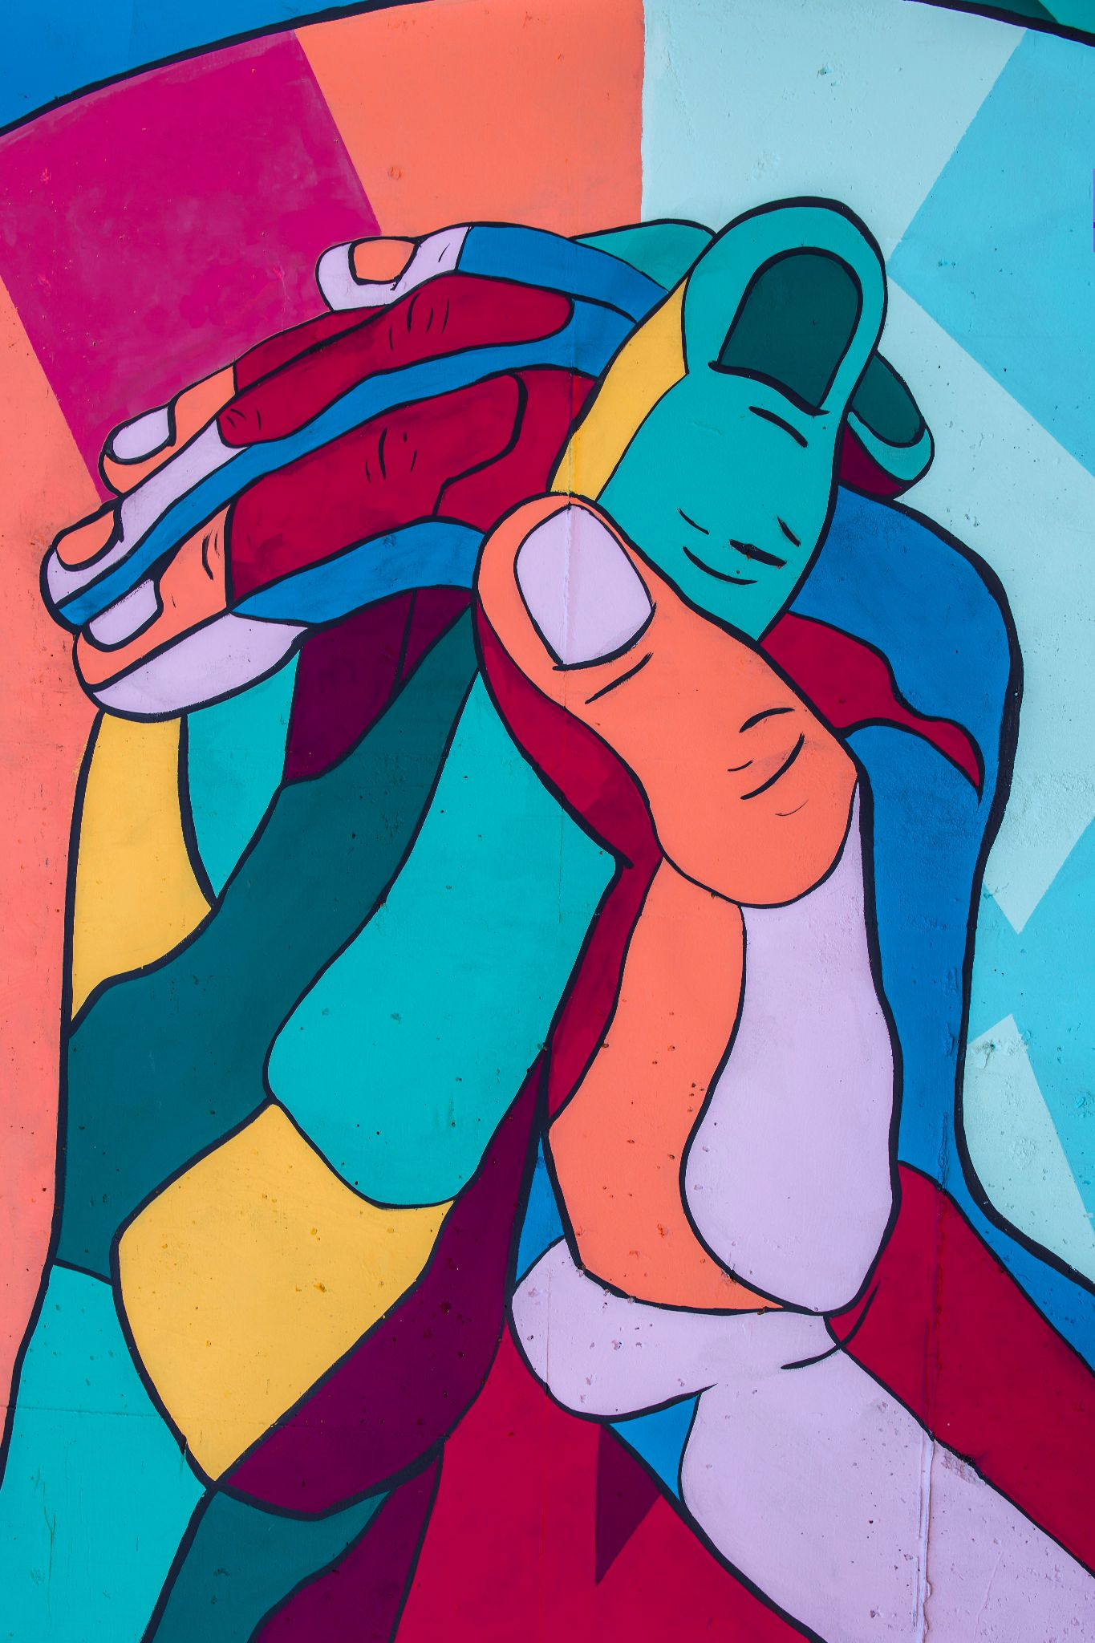
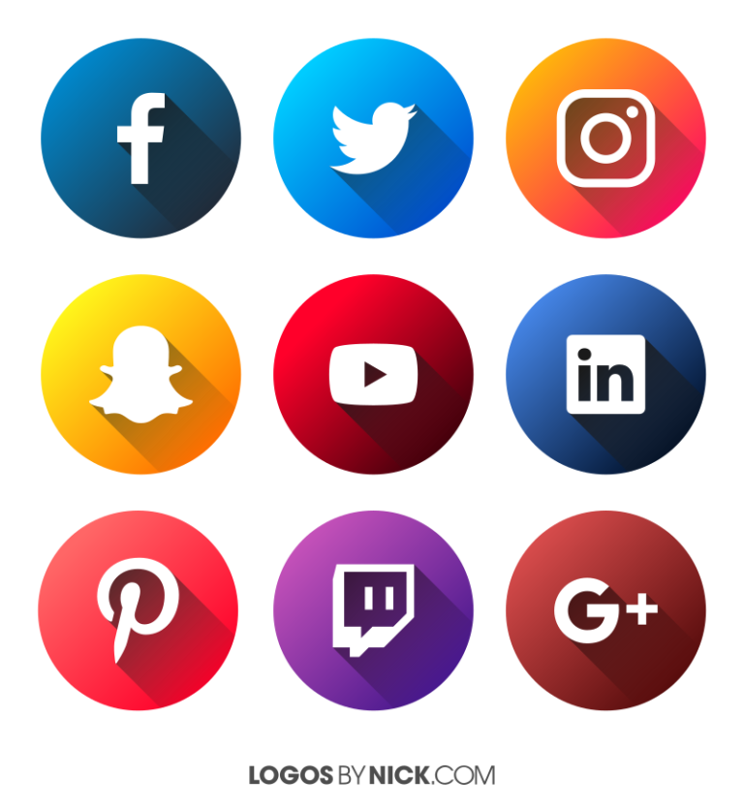
MY PLN + INCLUSION
PERSPECTIVES
LOCAL AND ABROAD COMMUNITIES OF PEOPLE
VOICES
INCLUSION IN MY PLN
MEDIUM OF USE
https://unsplash.com/photos/zs-PAgqgenQ?utm_source=unsplash&utm_medium=referral&utm_content=creditShareLink
RESEARCH PAPERS/ JOURNAL ARTICLE:
Cited & credible with raw data
BOOKS & PODCAST:
From people around the world
SOCIAL MEDIA: Bridging the gap, the spread of awareness/education.
Providing means of support and to use each application to its the best advantage to help mitigate the trouble of articulation especially when not using the right learning network for the goal in mind.
Notes:
In this slide i will go into the PLN and its inclusion
from what i gathered, i was able to group inclusion and diversity into two big portions. One being; voices and the second being medium of use.
When i point out voices, i am directing the attention to the different perspectives of local and abroad communities of people. We live in a day and age of where people are all interconnected be it the inter web or just strangers. Through different research papers, journal articles, which are cited and credible with raw data or to books/podcasts from people around the world or social media that helps bridge the gap, build awareness and still able to educate.
Secondly, when i said medium of use: i refer to the means of support by which, using each application; personalized learning network, articulation is rather tough especially when not using the right personalized learning network or even using these learning networks to its best advantage.

Slide 9
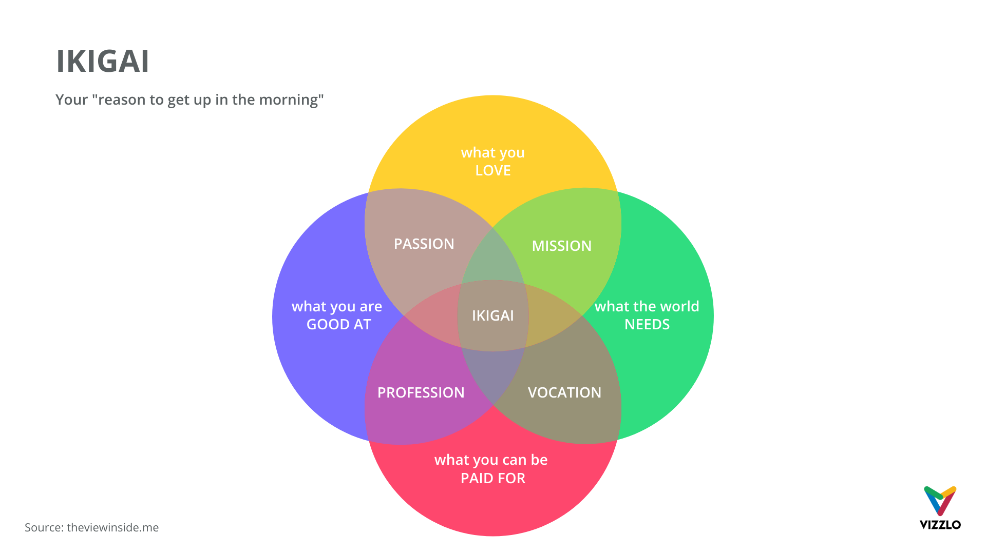
“SWEET SPOT”
Notes:
ooh my favourite venn diagram is this, shelley Moore talks about the sweet spot being the in between of passion, mission, vocation and profession. It reminded me of this concept introduced by the japanese called the ikigai.
what PLN do you think is your “sweet spot”?
I do not particular just have one PLN that properly encapsulates everything, i prefer having different aPLN for different reasons, For example, i use instagram and twitter to spread awareness and shed light on emotional intelligence while i use facebook and reddit to keep up with my local communities. I feel my ikigai changes from one function to another.

Slide 10
SHELLEY MOORE
Interchanging roles between teacher and student
Always learning & evolving
Each individual has all it takes to be successful
The Lens we use is shaped by all of our personalized learning networks and this helps us view the world.
The tools we use (PLN); important to have diversity and inclusion, so we can touch more hearts, hence, more resonance.
YOUTUBE LINK: Interview with Shelley Moore: https://www.youtube.com/watch?v=KeSV0rUl1bA
Notes:
Shelley was a great speaker in the interview. She managed to cover such amazing points. She began her interview with a beautiful introduction into her background and her life path and talked about her book on inclusion and diversity which she uses some really great visuals to help keep the readers in the know. Lastly she ended on such a great note about diversity nd inclusions. The biggest takeaways i managed to get was when she talked about how there is always an interchanging role between the teacher and a student and how we are always learning. She also goes on to mention how important it is to be able to shed our past versions of ourselves and our knowledge to constantly be able to embrace new and ever changing learning. She talks about how these learning networks helps us view the world and helps shed some biases and maybe also mitigate these information with new ones as we are, once again, like a sponge to be able to absorb more and more from what we are fed.
She later goes into how by doing so, we are able to reach more hearts, and more people can resonate. The vast importance of inclusion and diversity, still baffles me sometimes.

Slide 11
A Practical Application of PLN’s
Putting the work to the test → A Social Media Campaign
Campaign: Fundraiser within an environmental education organization
Prior to engaging:
Follow similar organizations
Study their communications
Engage in content
Creation of Campaign:
Frequent and consistent posts
Launch a countdown to the fundraiser
Notes:
Now that we know more about PLN’s, let’s look into the practical aspect of them, and how create a PLN to help us elevate a social media campaign.
The law of effort is pretty simple: the effort you put in is the effort you get out.
In knowing this, prior engaging a social media campaign on instagram for a fundraiser within an an environmental education organization, I would work on creating my PLN by following accounts for similar organizations and studying up on how they’ve attempted similar scenarios and engaging with their content. I would also participate in a few workshops and webinars focused on launching social media campaigns and make connections through those spaces.
In order to create the social media campaign, I would focus on posting frequently and consistently on Instagram using interesting photos coupled with fun facts. These posts would pose questions to the viewers asking for their engagement, and would be posted in a count down style to get the audience excited about the upcoming fundraiser.

Slide 12
How notable individuals use PLN
Jody Vance- sports broadcaster, now has own podcast
First female in Canadian history to host her own sports show
Jody talks about the reputation one holds when they are in the public eye
“It takes a lifetime to build a reputation and a heartbeat to break it” - Jody Vance
When in the public eye, reputation is a huge thing and must be taken care of closely to not slip up, can have big consequences
Companies have to be careful with who they hire, as their employees make up and influence their reputation
Notes:
Jody Vance- sports broadcaster (17 years), breakfast tv at citytv (5 years), own business now, podcast
First female in Canadian history to host her own sports show on prime time
Talks about reputation and how fragile it can be
Like jody said “It takes a lifetime to build a reputation and a heartbeat to break it” -Jody Vance
“Everything’s a postcard to the world” -Jody Vance
Which is why Companies have to be careful with who they hire, as their employees heavily make up and influence their reputation
When in the public eye, reputation is a huge thing and must be taken care of closely to not slip up, can have big consequences, specially when being an individual in the public eye
Example: A recent example in today's society, was the host of The Bachelor, Chris Harrison, getting fired over controversial comments
Chris had made a comment on national TV defending a former contestant’s racist behaviour, after photos circled around of Rachel Kirkconnel about attending an old south themed fraternity party a few years back. Chris later “stepped down” from his position of 20 years in order to protect the reputation of the show and ABC’s network
The company had to protect their reputation and also publicly make it known that they dont support what was done or said
Question: Do you think people should have freedom of expression on social media that doesn't affect their PLN and their professional PLN?
Pros and cons to free expression, but people need to clearly understand the possible consequences, especially being a notable individual people have to be extremely careful with what they say

Slide 13
How notable individuals use PLN Cont’d
A recent example in today's society, was the host of The Bachelor, Chris Harrison, getting fired over controversial comments
Chris made a comment on national TV defending a former contestant’s racist behaviour, and later “stepped down” from his position of 20 years in order to protect the reputation of the show and ABC’s network
Question: Do you think people should have freedom of expression on social media that doesn't affect their PLN and their professional PLN?
Pros and cons to free expression, but need to clearly understand the consequences being a notable individual
Notes:
Answer: I think freedom of speech is very important.
Pros: We can learn from each other if we have different views from each other. free expression can show the diversity of the world, especially when celebrities speak about social issues that have not been discovered.
cons: But at the same time, if we have different views, it may be about different religious beliefs, different cultures, which can lead to our speech not being understood and thus cyber violence by others.

Slide 14
Media Literacy
Media literacy is a kind of format to transfer people’s thoughts throughout their video, website, audio, or graph to people.
The social media is now very popular among young people, and a good mediator who has media literacy will be able to guide young people in a different way and establish good values for them.
Question: Do you think should everyone learn about media literacy? And why?

Slide 15
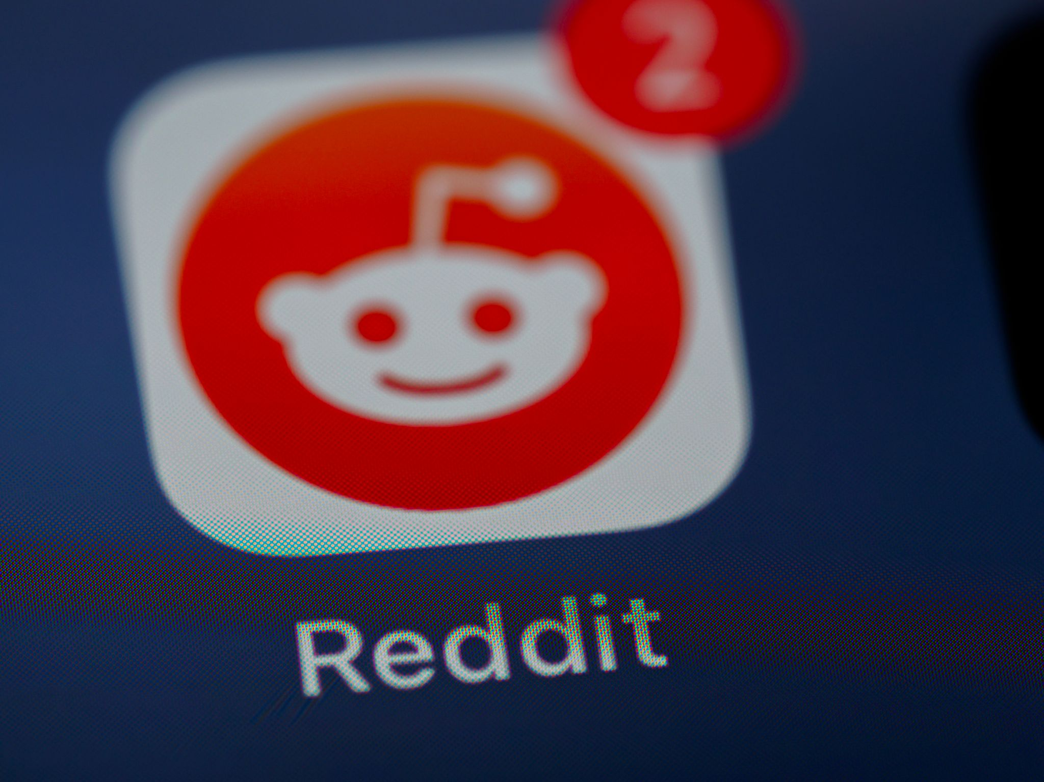
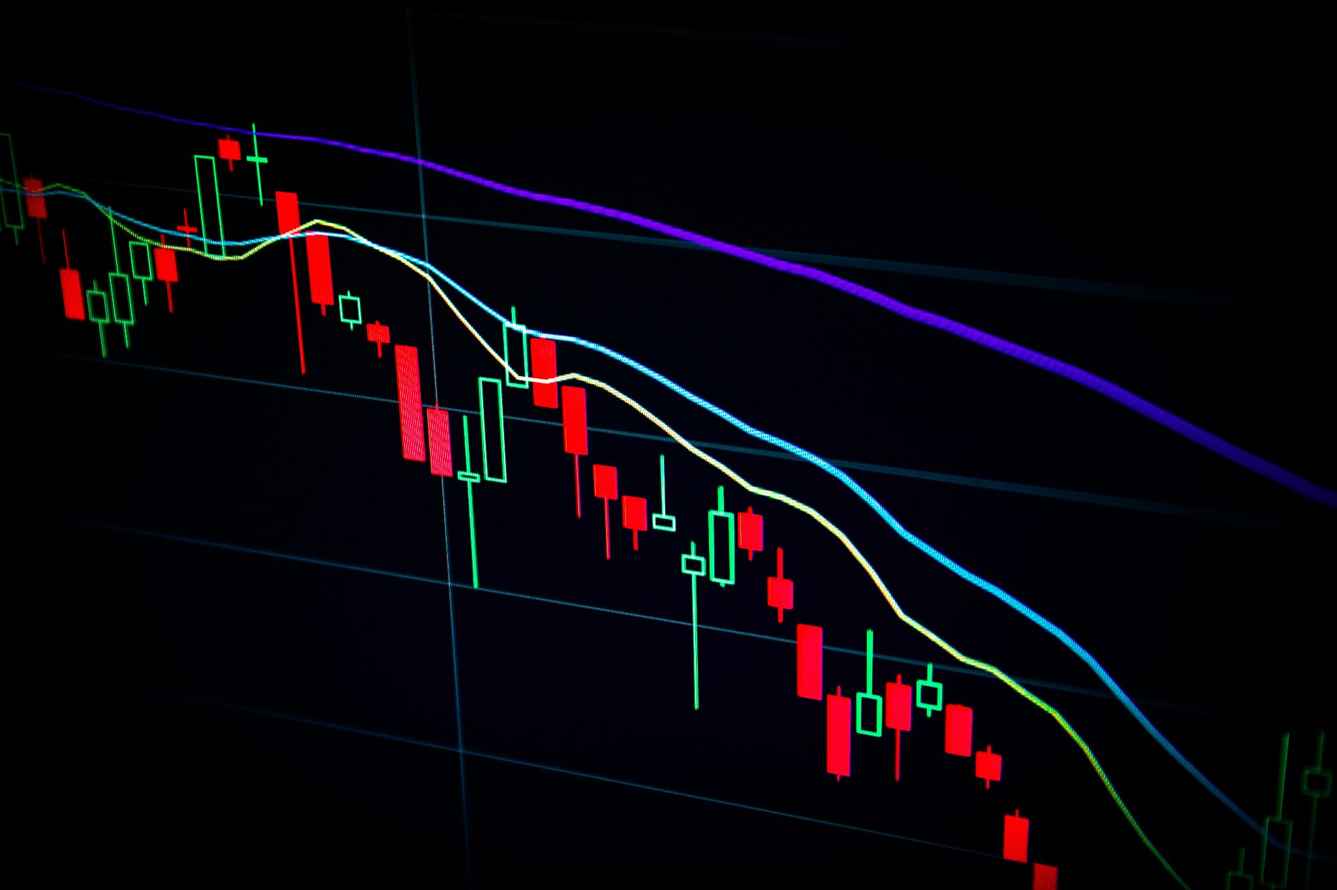
PLN + Education: A story on reddit and learning about the stock market.
Alarming how we did not get the chance to learn about financial education till we are in university or pursuing a degree in it when we all know the earlier we get into financial independence and learning about finance we are able to know way more!
Reddit happens to be a common social media platform that promotes anonymity. This connects users from different walks of life that share similar interests. At first, I did not know what the stock market is and its benefits, till the moment i typed “retiring at 30” in my search bar i got pulled into a subreddit: “personal finance canada” and from that moment on, it felt as if i was down the rabbit hole… that is when i realized the crazy amount of information around financial freedom, investing, stock markets and great/helpful links to other experts in the field.
It isn’t about what’s in the physical school curriculum but rather abstract, you are what you eat (consume). So feeding yourself, bit by bit, and indulging in a personalized learning networld that helps you jump into an ocean of passion, why hold back?
https://unsplash.com/photos/0FytazjHhxs?utm_source=unsplash&utm_medium=referral&utm_content=creditShareLink
https://unsplash.com/photos/fiXLQXAhCfk?utm_source=unsplash&utm_medium=referral&utm_content=creditShareLink
Notes:
larming how we did not get the chance to learn about financial education till we are in university or pursuing a degree in it when we all know the earlier we get into financial independence and learning about finance we are able to know way more!
Reddit happens to be a common social media platform that promotes anonymity. This connects users from different walks of life that share similar interests. At first, I did not know what the stock market is and its benefits, till the moment i typed “retiring at 30” in my search bar i got pulled into a subreddit: “personal finance canada” and from that moment on, it felt as if i was down the rabbit hole… that is when i realized the crazy amount of information around financial freedom, investing, stock markets and great/helpful links to other experts in the field.
It isn’t about what’s in the physical school curriculum but rather abstract, you are what you eat (consume). So feeding yourself, bit by bit, and indulging in a personalized learning networld that helps you jump into an ocean of passion, why hold back?

Slide 16
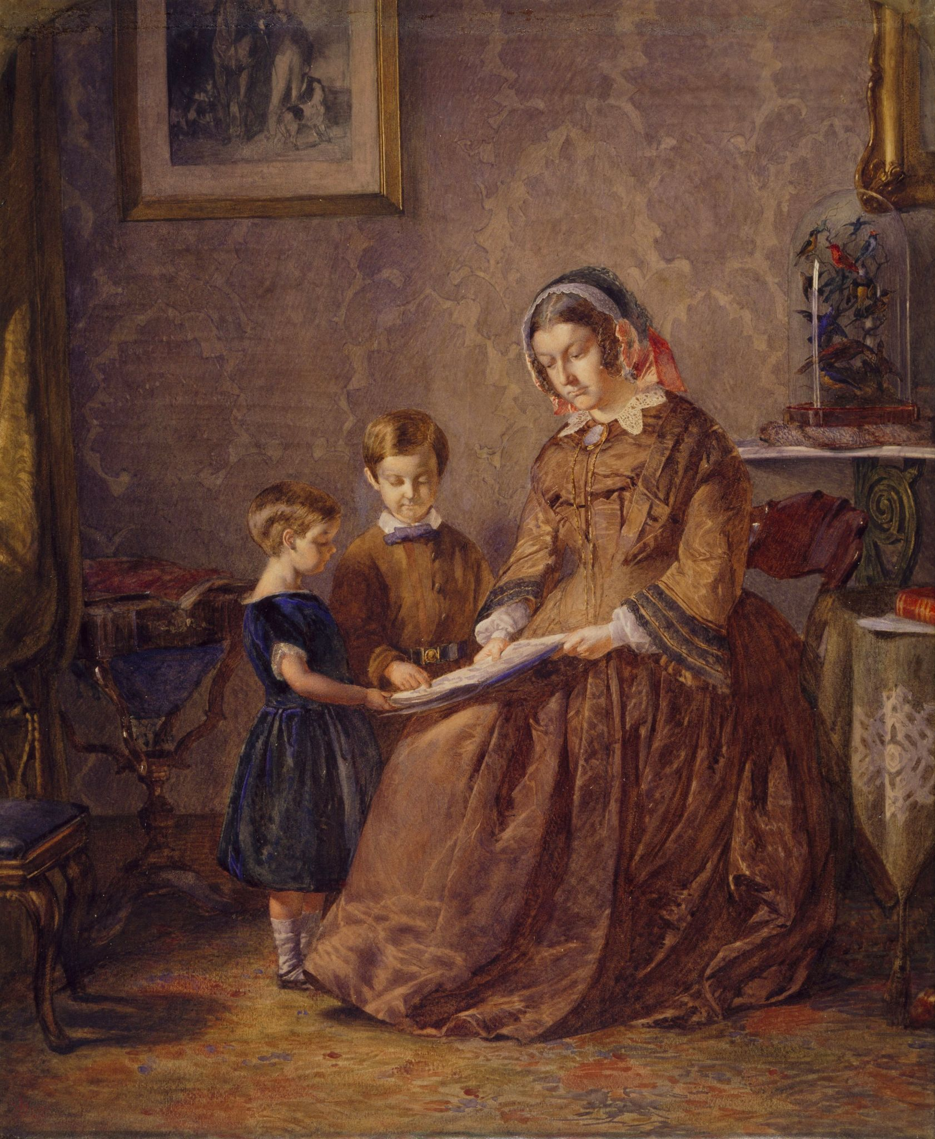
Why Media Literacy Matters in our PLN
RELIABLE
TRUSTWORTHY
CREDIBILITY
AUTHENTICITY
FLUENCY IN ARTICULATION
GROWTH & EVOLVING PERSPECTIVES OVER TIME
https://unsplash.com/photos/flaxAD9Hw4Y?utm_source=unsplash&utm_medium=referral&utm_content=creditShareLink
Notes:
Text from marissa’s blog: “Media literacy is so important because there is so much information just waiting to be consumed within the media, which gives ample opportunity for incorrect information to be passed around. On the opposite end of the spectrum there is the possibility that information is withheld from some people or pushed down and never allowed to surface. To be media literate is to have the ability to critically analyze information you find in the media, and to be able to form a good opinion based on true, solid information.
It’s important to have varied views within your PLN so you can have access to a wealth of different opinions and sources of information. In having this, you are able to use critical analysis skills to separate fact from fiction, and come to a consensus on your own, which will hopefully be the right one.”

Slide 17
Engaging our PLN
Mo Amir- creator is This Is Vancolour podcast
Has had very influential guests on his podcast ex: Jagmeet Singh NDP Leader
Started as a hobby, not realizing the potential and the importance of networking to achieve success
Emphasizes uniqueness of Twitter, allows for direct communication with new people
“Networks are really important, and i think your reputation as well in terms of how you work with others”- Mo Amir
Consistency, reliability, and credibility → have to prove it in your work
“Social media brings us together, helped the year be more normal” - Mo Amir
Notes:
When it comes to engaging pln, our guest mo talked a about a lot of great ways
Mo Amir- This Is Vancolour podcast, also works in forestry
Hes managed to have a various amount of influential guests on his podcast ex: Jagmeet Singh NDP Leader
Started as a hobby, not realizing the potential, not relying on it to pay bills
In conversation can see how humble he is about it, didnt expect much of it
Mo Realized while starting up his podcast that twitter allows for direct communication whether they follow you or not
And this Emphasizes uniqueness of Twitter and how facebook and instagram dont have the same aspects
As Mo said “Networks are really important, and i think your reputation as well in terms of how you work with others”
He talks about the importance of Consistency, reliability, credibility → and how you have to prove it in your work to show your reliability
Social media definitely helps to bring us together,it has helped the year to be more normal, without we would have been lost with little to no communication throughout isolation

Slide 18
Engaging your PLN
In my perspective, PLN can be used to help our professional development post-course. Because PLN is a platform that allows people to share their opinion.
there was an app in China called Tieba. The format of Tieba has similarities with PLN. The threshold for creating a group in Tieba is low, but if you are the creator, you can raise the threshold for other members who want to join the group.
Notes:
The conclusion: PLN is a very useful way to expand our own studies, and it also make a great connection between you and others. Especially, in this age of information explosion, if we can build our own PLN, it would be a good way to classify those message and we would definitely get improve as well.

Slide 19
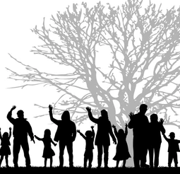
Thank You!
Julia Celinski
Julie Hu
Marissa Waddell
Yoghini Kandasamy

